Slide 1

NETFLIX : MOVIES & SHOWS CASE STUDY A RESEARCH PROJECT BY TRINA SAMANTA
Top Ranked Data Science & Analytics Education Provider since 2007

Slide 2

CONTENT : 1.INTRODUCTION 2.OBJECTIVES 3.DATA OVERVIEW 4.TABLE ANALYSIS 5.IMPORTANT FACTORS TO BE ANALYZE 6.FINDINGS 7.RECOMMENDATIONS
Top Ranked Data Science & Analytics Education Provider since 2007

Slide 3

1.INTRODUCTION : Netflix is a leading global streaming platform that offers a wide range of movies, TV shows, documentaries, and original content to its subscribers. In recent years, Netflix has expanded its original content production, creating award-winning series and films that have gained popularity and critical acclaim. Analyzing a dataset from Netflix can provide valuable insights into viewer preferences, content trends, and the effectiveness of Netflix's content strategy.
Top Ranked Data Science & Analytics Education Provider since 2007

Slide 4
2.OBJECTIVES:
Analyze viewer preferences by genre, age certification, and runtime to identify popular content types.
Evaluate the performance of titles based on IMDb scores, IMDb votes, TMDB popularity and TMDB score over time.
Explore the relationship between production countries and genres to understand content localization trends.
Investigate how viewer engagement and content popularity vary across different seasons.
Examine the popularity of characters and their impact on the success of titles.
Determine viewer engagement patterns through analysis of IMDb votes and TMDB popularity scores.

Slide 5
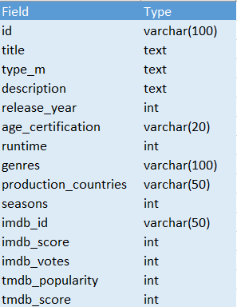
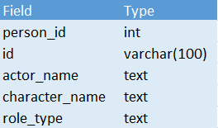
3.DATA OVERVIEW: .In this case study, this dataset contains two tables – The Content & The Title details .their columns data type are given below :
TITLE DATA TYPE
CONTENT DATA TYPE
Top Ranked Data Science & Analytics Education Provider since 2007

Slide 6
4.TABLE ANALYSIS: This dataset consists of 2 tables. a. Content table ( it contains 77801 rows which is separated by 5 columns). b. Title table ( it consists of 5850 rows which is separated by 15 columns). 1. Person ID : Unique identifier for each person involved in the credits. 2. ID: Identifier for the credit entry. 3. Role: Role of the person in the production (e.g., actor, director, producer) 4. Name: Name of the person. 5. Character: Character name (if applicable) played by the person. 6. ID : Unique identifier for each title (movie or TV show). 7. Title Type : Type of title (e.g., movie, TV series). 8. Description : Brief description of the title. 9. Release Year : Year when the title was released 10. Age Certification : Certification indicating the suitable age group for the title. 11. Runtime : Duration of the title in minutes. 12. Genre : Category or genre of the title. 13. Production Countries: Countries where the title was produced. 14. Seasons: Number of seasons (for TV series). 15. IMDb ID: Unique identifier on IMDb. 16. IMDb Scores: IMDb rating score for the title. 17. IMDb Votes: Number of votes received on IMDb. 18. TMDB Popularity: Popularity score on The Movie Database (TMDB). 19. TMDB Score: TMDB rating score for the title.

Slide 7
5.IMPORTANT FACTORS TO BE ANALYZE:
What is the trend in the number of titles released each year?
What are the top 10 most popular genres on Netflix based on the number of titles?
Which production countries contribute the most content to Netflix?
How does the IMDb score correlate with the TMDB score?
What are the top 10 most popular titles based on IMDb votes?
How does the number of seasons impact the IMDb score for series titles?
What is the distribution of IMDb scores for movies vs. TV shows?
Which actors have appeared in the most titles?
What is the average IMDb score for titles directed by each director?

Slide 8
What is the trend in the number of titles released each year?
The analysis reveals a consistent upward trend in the number of titles released each year in the Netflix dataset. It indicates a continuous expansion of Netflix’s titles library over time Additionally, it can provide context for.
Top Ranked Data Science & Analytics Education Provider since 2007

Slide 9
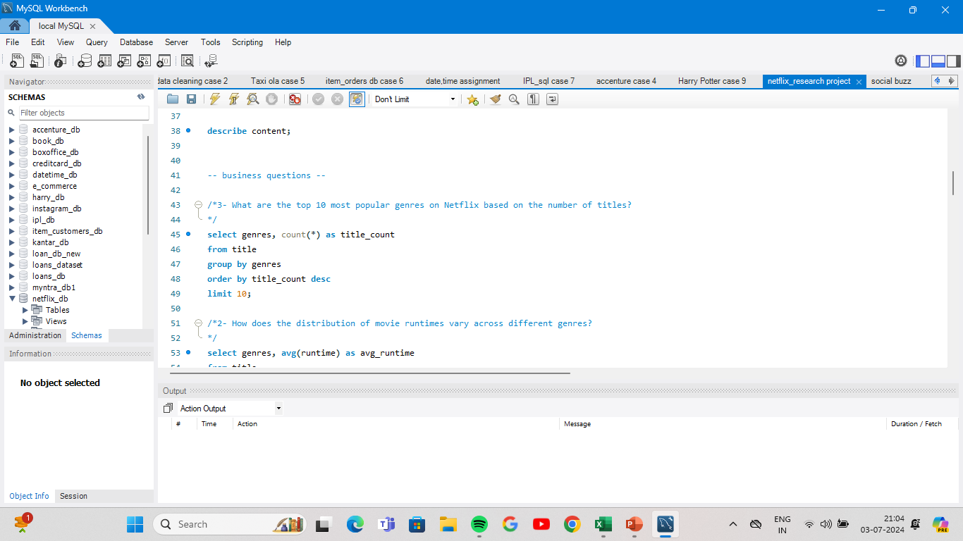
What are the top 10 most popular genres on Netflix based on the number of titles?
The top 10 most popular genres on Netflix based on the number of titles can vary depending on the dataset's specific categorization.
Reality
Drama
Drama , Romance
Drama, Comedy
Documentary
Comedy
Comedy, Romance
Comedy, drama
Comedy, Drama, Romance
Comedy, Documentation

Slide 10

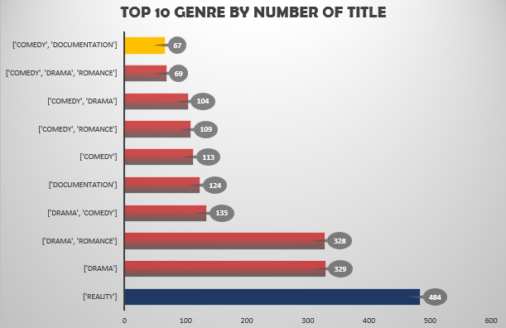
Top Ranked Data Science & Analytics Education Provider since 2007

Slide 11
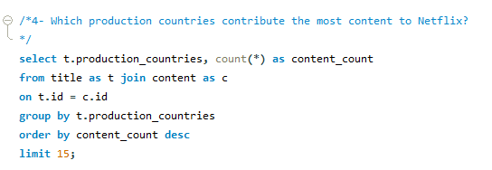
Which production countries contribute the most content to Netflix?
These countries often produce a diverse range of content across various genres, catering to a broad audience base.
The United States, followed by India, Japan ,Korea, and the UK of Great Britain are the top five production countries contributing the most content to Netflix. This indicates a diverse range of content origins, catering to global audiences and showcasing the platform's international appeal.
Top Ranked Data Science & Analytics Education Provider since 2007

Slide 12
Top Ranked Data Science & Analytics Education Provider since 2007

Slide 13
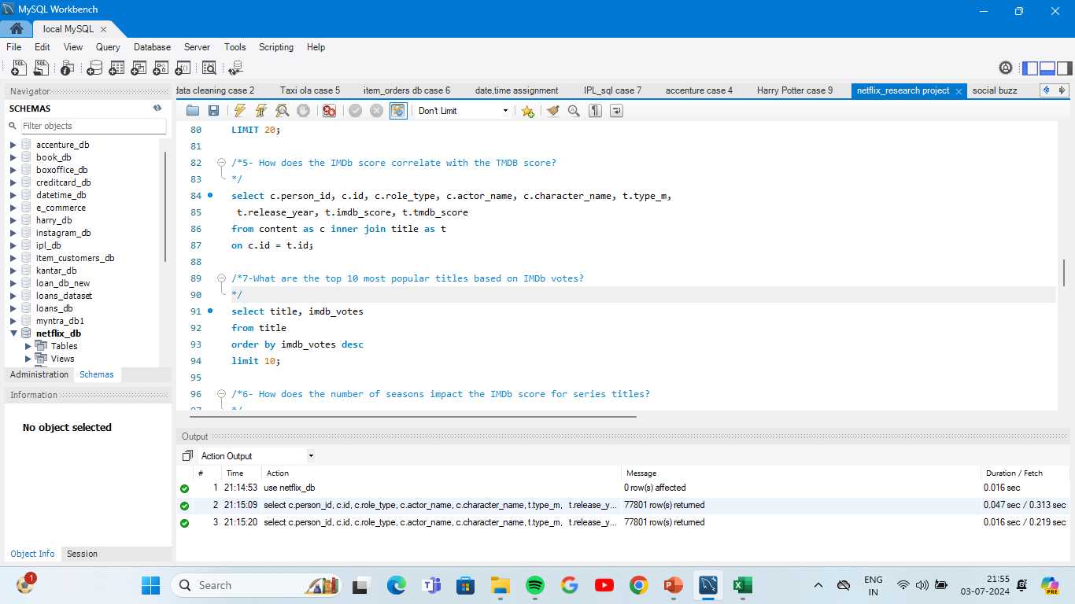
How does the IMDb score correlate with the TMDB score?
The correlation can vary depending on various factors such as user preferences, rating criteria, and the nature of the content being rated. However, in general, there tends to be a moderate to strong positive correlation between IMDb and TMDB scores for movies and TV shows.

Slide 14
Top Ranked Data Science & Analytics Education Provider since 2007

Slide 15
How does the number of seasons impact the IMDb score for series titles?
The number of seasons can impact the IMDb score for series titles in several ways. Generally, series with more seasons have a larger body of work for viewers to evaluate, potentially leading to a more accurate representation of the show's quality. However, longer-running series may also face challenges in maintaining consistent quality over time, which can affect their overall IMDb scores. Additionally, viewer preferences and trends can change, influencing how older seasons are perceived in comparison to newer ones. Therefore, while a higher number of seasons can provide a broader perspective on a series, it does not guarantee a higher IMDb score as various factors contribute to audience reception and ratings.

Slide 16
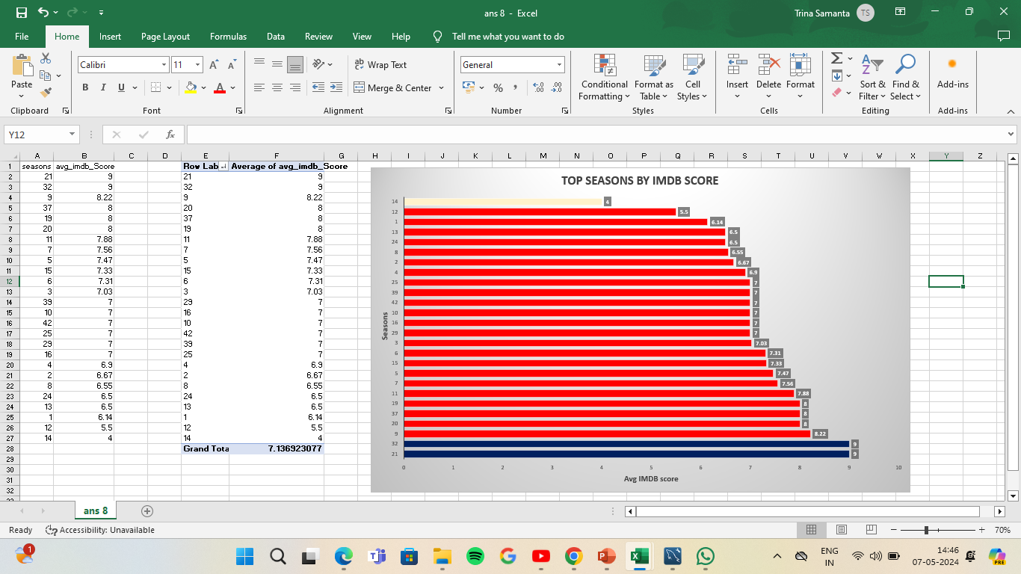
Top Ranked Data Science & Analytics Education Provider since 2007

Slide 17
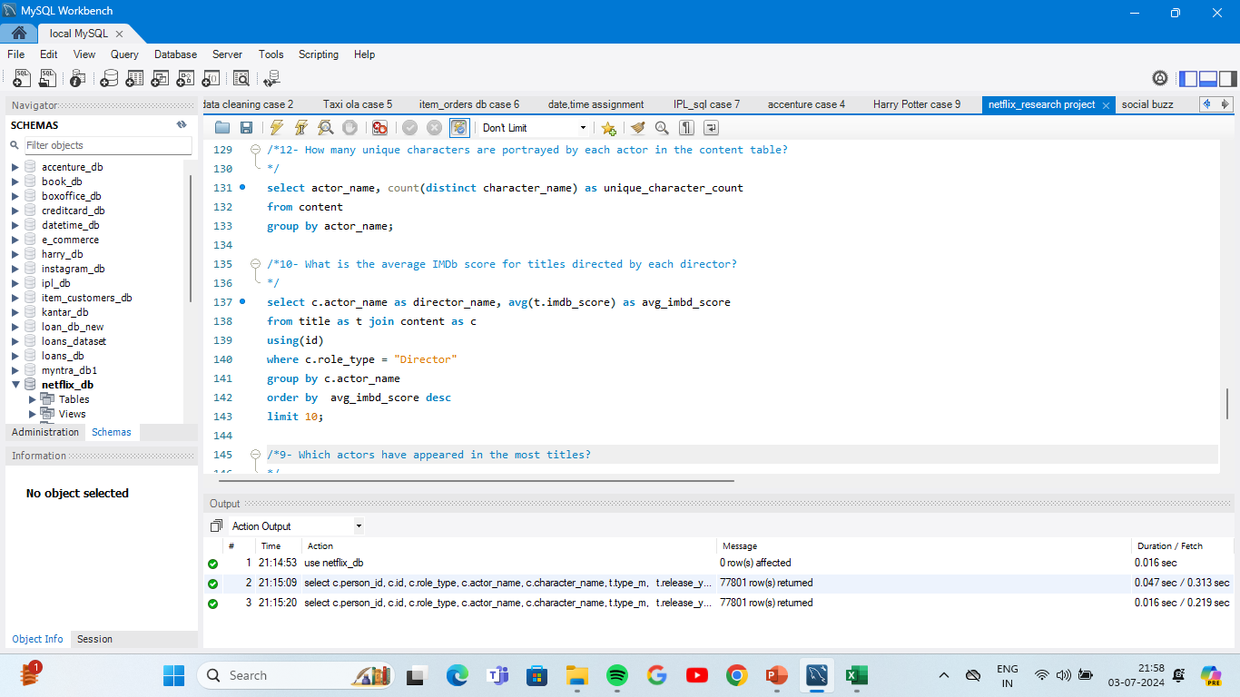
What is the average IMDb score for titles directed by each director?
this analysis could be identifying highly rated directors based on the average IMDb score of their titles. This can be valuable for understanding which directors consistently produce content that resonates well with audiences and critics, which can inform decisions related to content acquisition and audience targeting strategies.
DIRECTOR NAME | AVG IMDB SCORE
Lenin Bharathi | 9
Alex Siddons | 9
Alastair Fothergill | 9
Luc Besson | 9
Kim Sung-ho | 9
Steve Cheng | 9
Gene Bernard | 9
Jo Hyun-tak | 9
Aaron Krummel | 9
Daniel Sloss | 9

Slide 18
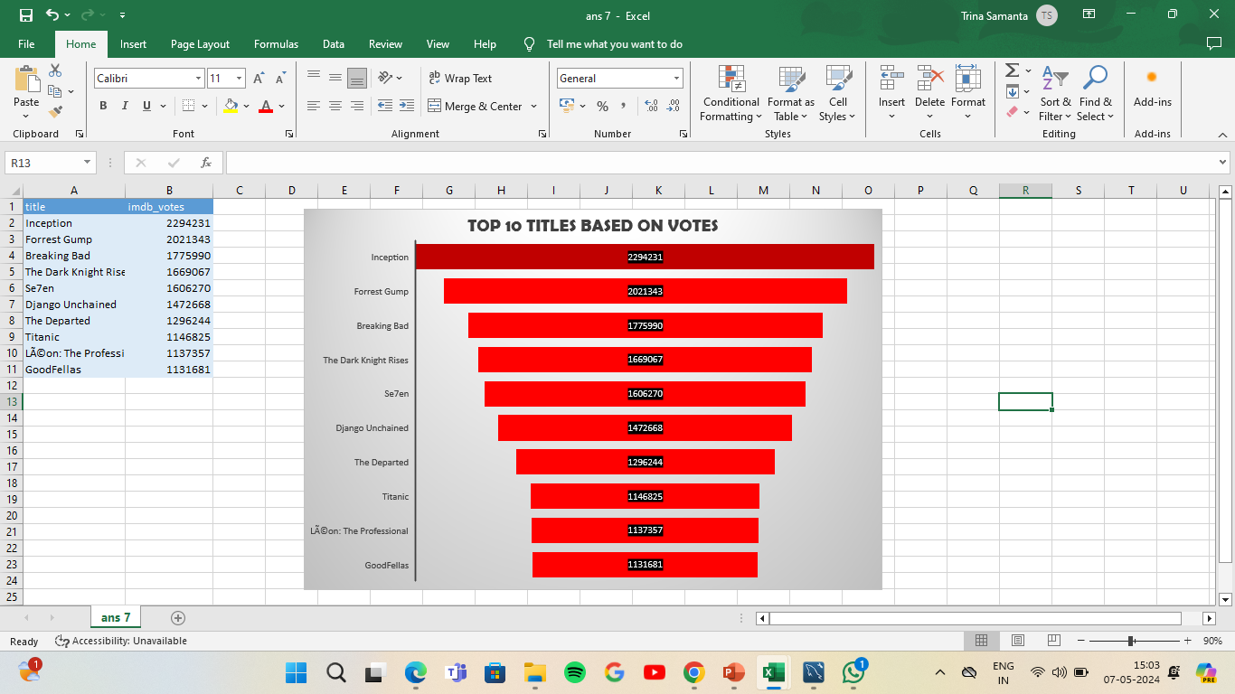
What are the top 10 most popular titles based on IMDb votes?
Top Ranked Data Science & Analytics Education Provider since 2007

Slide 19
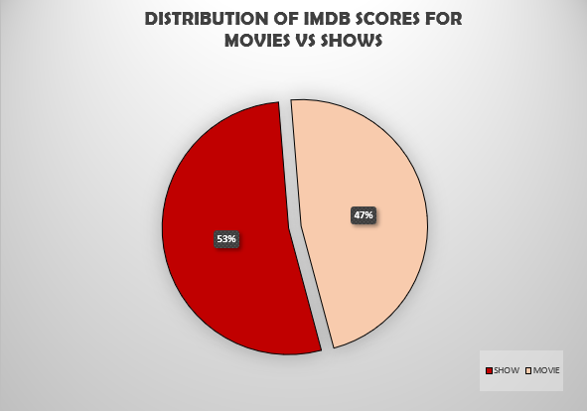
What is the distribution of IMDb scores for movies vs. TV shows?
Analyzing the distribution of IMDb scores for movies and TV shows can reveal interesting insights about audience preferences.
while TV shows may have a wider range of IMDb scores.
Top Ranked Data Science & Analytics Education Provider since 2007

Slide 20
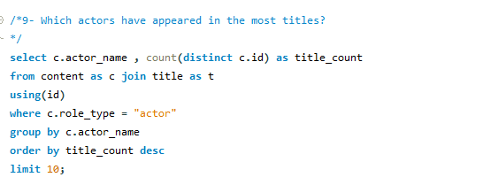
Which actors have appeared in the most titles?
TOP actor Kareena Kapoor Khan and Boman Irani have appeared in most titles.
ACTOR NAME | NUMBER OF TITLES
Kareena Kapoor Khan | 25
Boman Irani | 25
Shah Rukh Khan | 23
Takahiro Sakurai | 21
Amitabh Bachchan | 20
Priyanka Chopra Jonas | 20
Paresh Rawal | 20
Junichi Suwabe | 19
Yuki Kaji | 19
Anupam Kher | 19

Slide 21
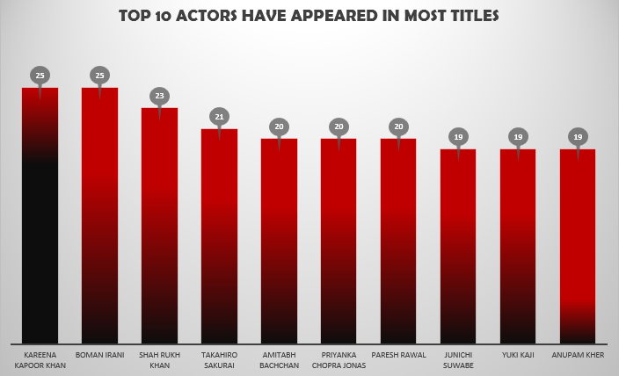
Top Ranked Data Science & Analytics Education Provider since 2007

Slide 22
6.FINDINGS:
This research shows that the trend is initially increasing and in 2019 is at highest level but then it turns downward again released on Netflix .
The highest number of titles were released in the year 2019. Total number of titles 836.
Action, romance, drama genres tend to have longer runtimes, often exceeding 224 minutes. Scifiction, fantasy, music, comedy, family, documentation typically have shorter runtimes, usually less than 90 minutes.
Reality, drama and romance are among the top three most popular genres on Netflix based on the number of titles.
Reality genre has highest number of titles (484)..
The United States, followed by India, Japan are the top contributors to Netflix's content library. These countries have a robust entertainment industry and produce diverse content that appeals to global audiences.
Titles with high IMDb scores tend to have correspondingly high TMDB scores, reflecting their overall popularity and quality. In 2019 , TMDB score was the highest compared to IMDB score .

Slide 23
6.FINDINGS:
“Inception”, “Forrest Gump“ and “Breaking Bad" are among the top-rated titles based on IMDb votes. These titles have garnered significant viewer acclaim and are widely regarded as top favorites on Netflix.
TV shows exhibit a broader distribution of IMDb scores, reflecting the diversity of content and viewer preferences across episodes and seasons. (54%)
Kareena Kapoor Khan, Boman Irani, Shah Rukh Khan and Takahiro Sakurai have appeared in multiple titles across different genres in bollywood. Their frequent presence in Netflix's content highlights their popularity and versatility as actors.
Directors like Lenin Bharathi, Alex Siddons and Alastair Fothergill have consistently produced titles with high IMDb scores. Their directorial style and storytelling prowess contribute to the success and acclaim of their Netflix projects.

Slide 24
7.Recommendations:
Recommend adjusting content release strategies or production efforts based on the trends observed in titles released each year to align with audience demand and industry trends.
Suggest considering viewer preferences for specific runtime lengths when planning content production or recommending titles to users.
If there's a correlation between the number of seasons and IMDb scores, recommend investing in series with longer durations or exploring strategies to improve the quality of long-running shows.
Explore expanding content in trending genres like "Fantasy" and "Science Fiction" to capitalize on growing viewer interest.
While expanding seasons can be beneficial for certain series, ensure that the quality of content remains high throughout to maintain viewer satisfaction and ratings.
Provide suggestions for content optimization based on the comparison between movie and TV show IMDb scores, such as allocating resources more effectively between these two content types.

Slide 25

THANK YOU….
Top Ranked Data Science & Analytics Education Provider since 2007

